Slide 1
Profit, Loss and Discount
Basic terms
Basic formulas
Calculation of Profit/Loss by % concepts (Multiplication factor and Successive % change formula)
To use multiplication factor to calculate Profit or Loss
Successive discounts
Concept of free items
Profit or Loss by Weighted average
Some important formulas
False weights

Slide 2
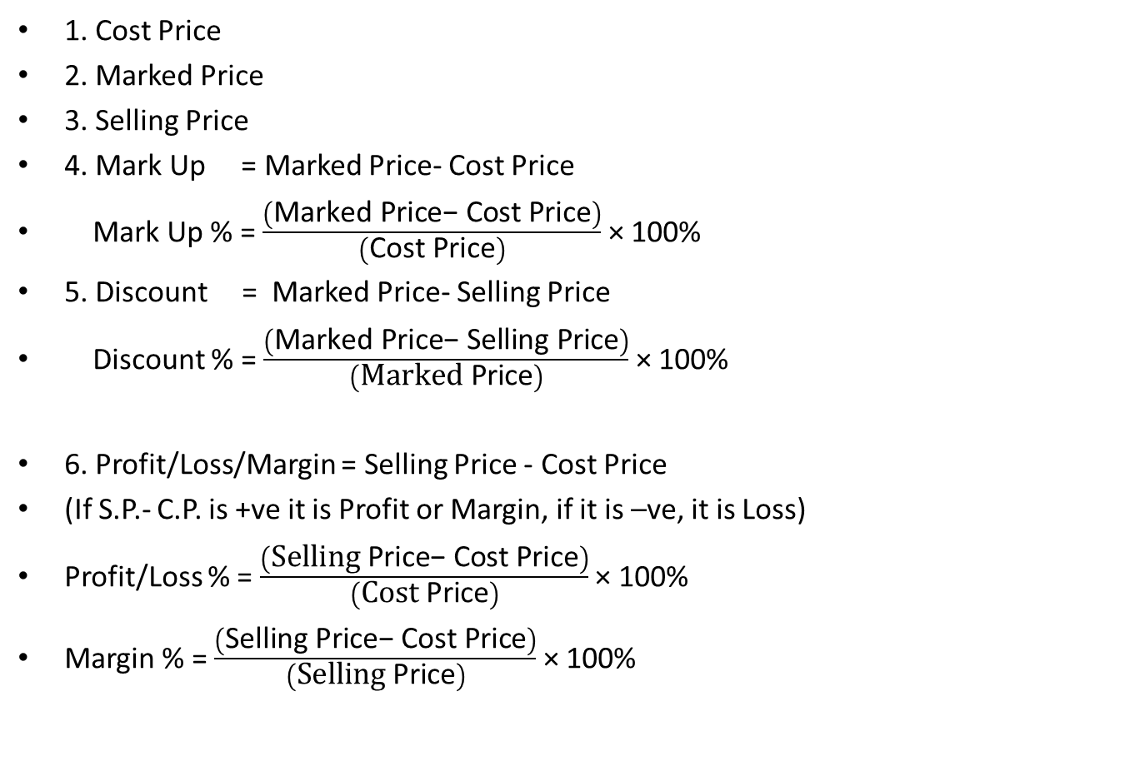
Basic terms
1. Cost Price
2. Marked Price
3. Selling Price
4. Mark Up = Marked Price- Cost Price
Mark Up % = $\frac{\left(\text{Marked} \text{Price}\text{− }\text{Cost} \text{Price}\right)}{\left(\text{Cost} \text{Price}\right)}$ × 100%
5. Discount = Marked Price- Selling Price
Discount % = $\frac{\left(\text{Marked} \text{Price}\text{− }\text{Selling} \text{Price}\right)}{\left(\text{Marked} \text{Price}\right)}$ × 100%
6. Profit/Loss/Margin = Selling Price - Cost Price
(If S.P.- C.P. is +ve it is Profit or Margin, if it is –ve, it is Loss)
Profit/Loss % = $\frac{\left(\text{Selling} \text{Price}\text{− }\text{Cost} \text{Price}\right)}{\left(\text{Cost} \text{Price}\right)}$ × 100%
Margin % = $\frac{\left(\text{Selling} \text{Price}\text{− }\text{Cost} \text{Price}\right)}{\left(\text{Selling} \text{Price}\right)}$ × 100%

Slide 3
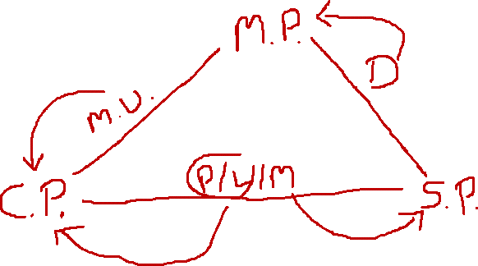


Interrelation between the basic terms

Slide 4
Using Multiplication factor
S.P. = (1+P%) C.P.
(1-L%) C.P.
M.P. = (1+M.U.%) C.P.
S.P. = (1-D%) M.P.
S.P. = (1+M.U.%)(1-D%) C.P.

Slide 5
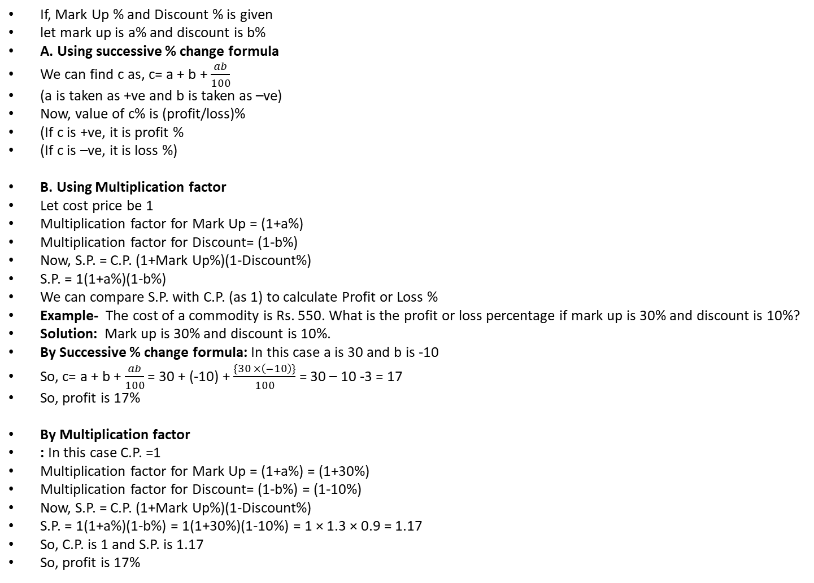
To calculate Profit/Loss by percentage
If, Mark Up % and Discount % is given
let mark up is a% and discount is b%
A. Using successive % change formula
We can find c as, c= a + b + $\frac{ab}{100}$
(a is taken as +ve and b is taken as –ve)
Now, value of c% is (profit/loss)%
(If c is +ve, it is profit %
(If c is –ve, it is loss %)
B. Using Multiplication factor
Let cost price be 1
Multiplication factor for Mark Up = (1+a%)
Multiplication factor for Discount= (1-b%)
Now, S.P. = C.P. (1+Mark Up%)(1-Discount%)
S.P. = 1(1+a%)(1-b%)
We can compare S.P. with C.P. (as 1) to calculate Profit or Loss %
Example- The cost of a commodity is Rs. 550. What is the profit or loss percentage if mark up is 30% and discount is 10%?
Solution: Mark up is 30% and discount is 10%.
By Successive % change formula: In this case a is 30 and b is -10
So, c= a + b + $\frac{ab}{100}$ = 30 + (-10) + $\frac{\{30 ×\left(−10\right)\}}{100}$ = 30 – 10 -3 = 17
So, profit is 17%
By Multiplication factor
: In this case C.P. =1
Multiplication factor for Mark Up = (1+a%) = (1+30%)
Multiplication factor for Discount= (1-b%) = (1-10%)
Now, S.P. = C.P. (1+Mark Up%)(1-Discount%)
S.P. = 1(1+a%)(1-b%) = 1(1+30%)(1-10%) = 1 × 1.3 × 0.9 = 1.17
So, C.P. is 1 and S.P. is 1.17
So, profit is 17%

Slide 6
Successive Discounts
Example: A sale is offering 2 discounts of 30% and 40%. If an item is sold at Rs.840 after the discounts, find the amount of discount offered?
a. Rs.1160 b. Rs. 2000 c. Rs. 1540 d. None of These
Approach
1. using successive formula:
2. Arrow method
3. Multiplication factor

Slide 7
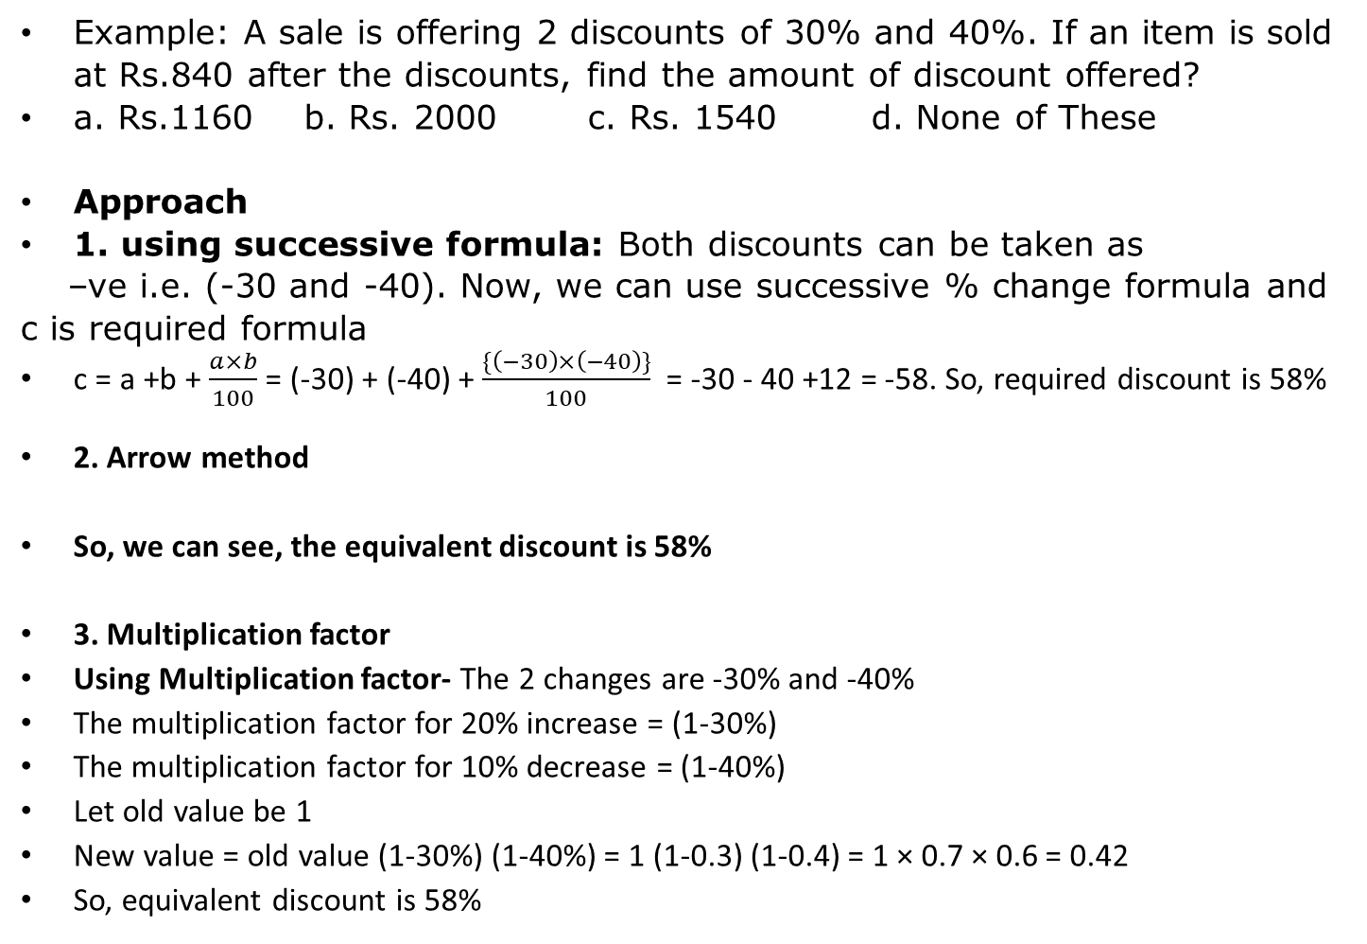

Successive Discounts
Example: A sale is offering 2 discounts of 30% and 40%. If an item is sold at Rs.840 after the discounts, find the amount of discount offered?
a. Rs.1160 b. Rs. 2000 c. Rs. 1540 d. None of These
Approach
1. using successive formula: Both discounts can be taken as
–ve i.e. (-30 and -40). Now, we can use successive % change formula and c is required formula
c = a +b + $\frac{a×b}{100}$ = (-30) + (-40) + $\frac{\{\left(−30\right)×\left(−40\right)\}}{100}$ = -30 - 40 +12 = -58. So, required discount is 58%
2. Arrow method
So, we can see, the equivalent discount is 58%
3. Multiplication factor
Using Multiplication factor- The 2 changes are -30% and -40%
The multiplication factor for 20% increase = (1-30%)
The multiplication factor for 10% decrease = (1-40%)
Let old value be 1
New value = old value (1-30%) (1-40%) = 1 (1-0.3) (1-0.4) = 1 × 0.7 × 0.6 = 0.42
So, equivalent discount is 58%

Slide 8
To use multiplication factor to calculate Profit or Loss (a CP = b S.P.)
Example 1 : If the cost price of 25 items is equal to the selling price of 15 items, find the profit or loss % earned?
a. 10 % profit b. 40% profit c. 16.66% profit d. 66.66% profit
Example 2 : Vijay purchased 35 Kg of rice for Rs. 1400 and sold it at a profit of as much money as he received for 10 Kg. Find the selling price of rice in Rs./Kg?
a. Rs.56 b. Rs.40 c. Rs.140 d. None of These
Example 3 : On selling 20 metres of cloth, a merchant realizes that he has made a loss equal to the selling price of 4 metres of cloth. Find his loss in percentage terms?
a. 20% b. 16.66% c. 15% d. 12.5%
Approach: We can find the relation between C.P. and S.P. for same quantity

Slide 9
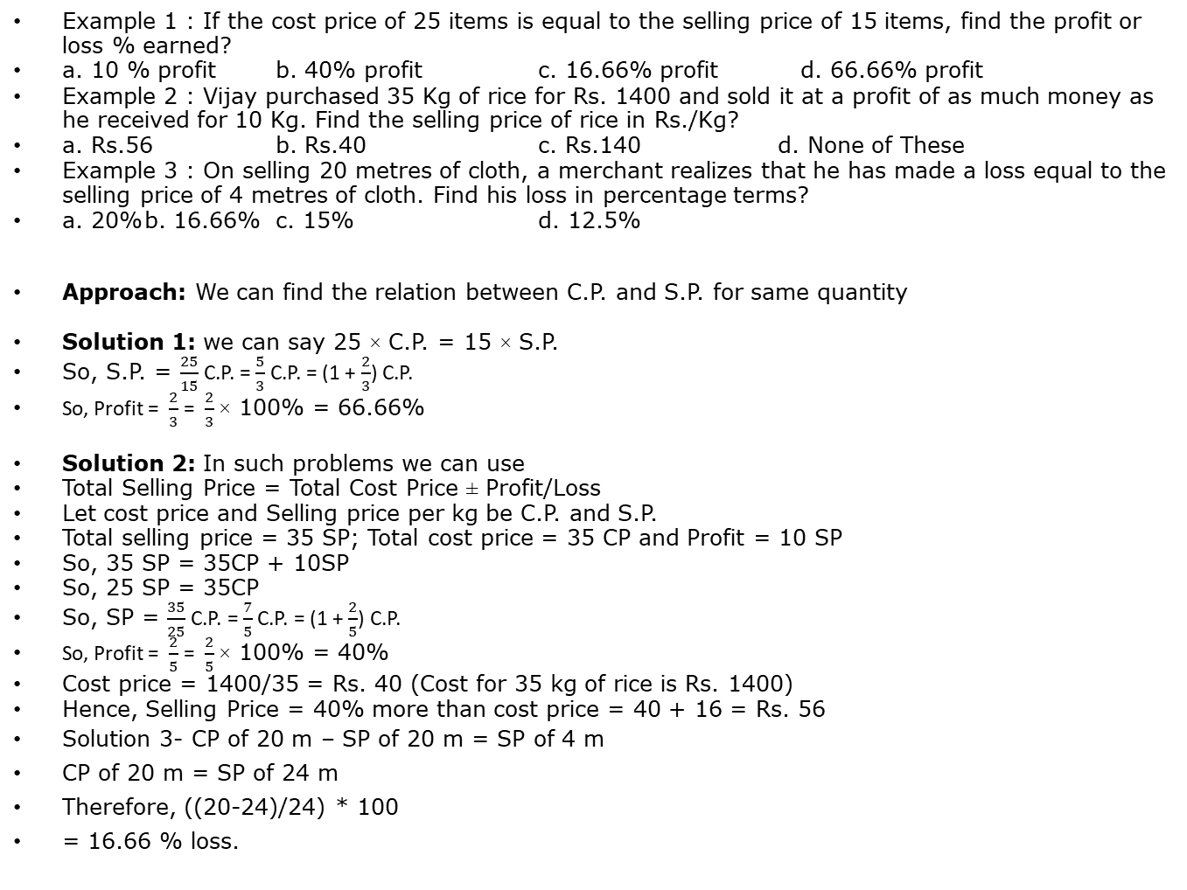
To use multiplication factor to calculate Profit or Loss
Example 1 : If the cost price of 25 items is equal to the selling price of 15 items, find the profit or loss % earned?
a. 10 % profit b. 40% profit c. 16.66% profit d. 66.66% profit
Example 2 : Vijay purchased 35 Kg of rice for Rs. 1400 and sold it at a profit of as much money as he received for 10 Kg. Find the selling price of rice in Rs./Kg?
a. Rs.56 b. Rs.40 c. Rs.140 d. None of These
Example 3 : On selling 20 metres of cloth, a merchant realizes that he has made a loss equal to the selling price of 4 metres of cloth. Find his loss in percentage terms?
a. 20% b. 16.66% c. 15% d. 12.5%
Approach: We can find the relation between C.P. and S.P. for same quantity
Solution 1: we can say 25 × C.P. = 15 × S.P.
So, S.P. = $\frac{25}{15}$ C.P. = $\frac{5}{3}$ C.P. = (1 + $\frac{2}{3}$) C.P.
So, Profit = $\frac{2}{3}$ = $\frac{2}{3}$ × 100% = 66.66%
Solution 2: In such problems we can use
Total Selling Price = Total Cost Price ± Profit/Loss
Let cost price and Selling price per kg be C.P. and S.P.
Total selling price = 35 SP; Total cost price = 35 CP and Profit = 10 SP
So, 35 SP = 35CP + 10SP
So, 25 SP = 35CP
So, SP = $\frac{35}{25}$ C.P. = $\frac{7}{5}$ C.P. = (1 + $\frac{2}{5}$) C.P.
So, Profit = $\frac{2}{5}$ = $\frac{2}{5}$ × 100% = 40%
Cost price = 1400/35 = Rs. 40 (Cost for 35 kg of rice is Rs. 1400)
Hence, Selling Price = 40% more than cost price = 40 + 16 = Rs. 56
Solution 3- CP of 20 m – SP of 20 m = SP of 4 m
CP of 20 m = SP of 24 m
Therefore, ((20-24)/24) * 100
= 16.66 % loss.

Slide 10
Profit or Loss by Weighted average
Q 1 : A person bought 60 items from the market. 20% of the total items were rotten. The rest were sold at 30% profit each. Find the overall % profit or loss?
a. 4% profit b. 10% profit c. 4% loss d. 12 % profit
Q2 : I purchased 60 oranges from the Market, sold 1/3rd at a loss of 20% and the remaining at 10% profit. Find the overall % profit or loss?
No Profit, No loss b. 10 % profit c. 10% loss d. 6.66 % loss

Slide 11
Profit or Loss by Weighted average
Q 1 : A person bought 60 items from the market. 20% of the total items were rotten. The rest were sold at 30% profit each. Find the overall % profit or loss?
a. 4% profit b. 10% profit c. 4% loss d. 12 % profit
Q2 : I purchased 60 oranges from the Market, sold 1/3rd at a loss of 20% and the remaining at 10% profit. Find the overall % profit or loss?
No Profit, No loss b. 10 % profit c. 10% loss d. 6.66 % loss
Solution 1: (1/5)*-100 + (4/5)*30
-20+24 = 4% profit
Solution 2: 1/3 (-20) + 2/3 (10)
= -20/3 + 20/3 = 0
= no profit, no loss

Slide 12
Using Total Cost Price and Total Selling Price
In such problems we need to compare total cost price and total selling price to find the required answer
Q1 : A man buys 2 dozen bananas at Rs.16 per dozen. After selling 18 bananas at the rate of Rs.12 per dozen, the shopkeeper reduced the rate to Rs.4 per dozen. Find the loss percent?
a. 25.2% b. 32.4% c. 36.5% d. 37.5%
Q2 : A man buys 144 oranges at the rate of Rs.18 per dozen and sells them for a total amount of Rs. 237.60. Find the percentage profit or loss?
a. 10 % b. 15% c. 20% d. 25%

Slide 13
Using Total Cost Price and Total Selling Price
In such problems we need to compare total cost price and total selling price to find the required answer
Q1 : A man buys 2 dozen bananas at Rs.16 per dozen. After selling 18 bananas at the rate of Rs.12 per dozen, the shopkeeper reduced the rate to Rs.4 per dozen. Find the loss percent?
a. 25.2% b. 32.4% c. 36.5% d. 37.5%
Q2 : A man buys 144 oranges at the rate of Rs.18 per dozen and sells them for a total amount of Rs. 237.60. Find the percentage profit or loss?
a. 10 % b. 15% c. 20% d. 25%
Solution 1: Ans 9 : Option d
Total Cost Price of the Bananas = Rs.32
While selling 18 Bananas are sold at a price of Rs.12 per dozen.
Amount earned = Rs.18
Remaining Bananas are sold at the rate of Rs.4 per dozen. Since the remaining Bananas constitute half a dozen therefore the amount earned will be Rs.2.
Total selling price = Rs.20.
Therefore, ((20-32)/32)*100 = -300/8 = -150/4 = 37.5% loss
Solution 2: solve yourself

Slide 14
Using Total Cost Price and Total Selling Price
In such problems we need to compare total cost price and total selling price to find the required answer
Q3 : A man buys an item at a discount of 20%. He spends Rs.200 on it’s repairs and sells it for Rs. 600 at a profit of 20%. Find the marked price of the item?
a. 300 b. 500 c. 375 d. 400

Slide 15
Using Total Cost Price and Total Selling Price
In such problems we need to compare total cost price and total selling price to find the required answer
Q3 : A man buys an item at a discount of 20%. He spends Rs.200 on it’s repairs and sells it for Rs. 600 at a profit of 20%. Find the marked price of the item?
a. 300 b. 500 c. 375 d. 400
Solution 3: The man sold the item for Rs.600 at a profit of 20%. Let x be the cost price for the man.
Therefore, x (120/100) = 600
or, x=Rs.500.
He has spent a total of Rs.200 on it’s repairs and therefore the cost price of the product for the man must be Rs.300.
He got this after a discount of 20%.
Let the marked price of the product be Y.
Therefore, Y x (80/100) = Rs.300
or Y = Rs.375.

Slide 16
Free Items
Example 1 : A shop advertises that it will give 2 items free with purchase of every 3 items of the same price. What is the % discount being offered?
a. 66.66% b. 40% c. 60% d. None of These
Example 2 : A shopkeeper gives 4% discount on the marked price and gives 1 article free for buying every 15 articles and thus gains 35%. The marked price is above the cost price by
a. 20% b. 39% c. 40% d. 50%
Approach: we can find marked price and selling price by given data.( Please check solutions for understanding the required approach)

Slide 17
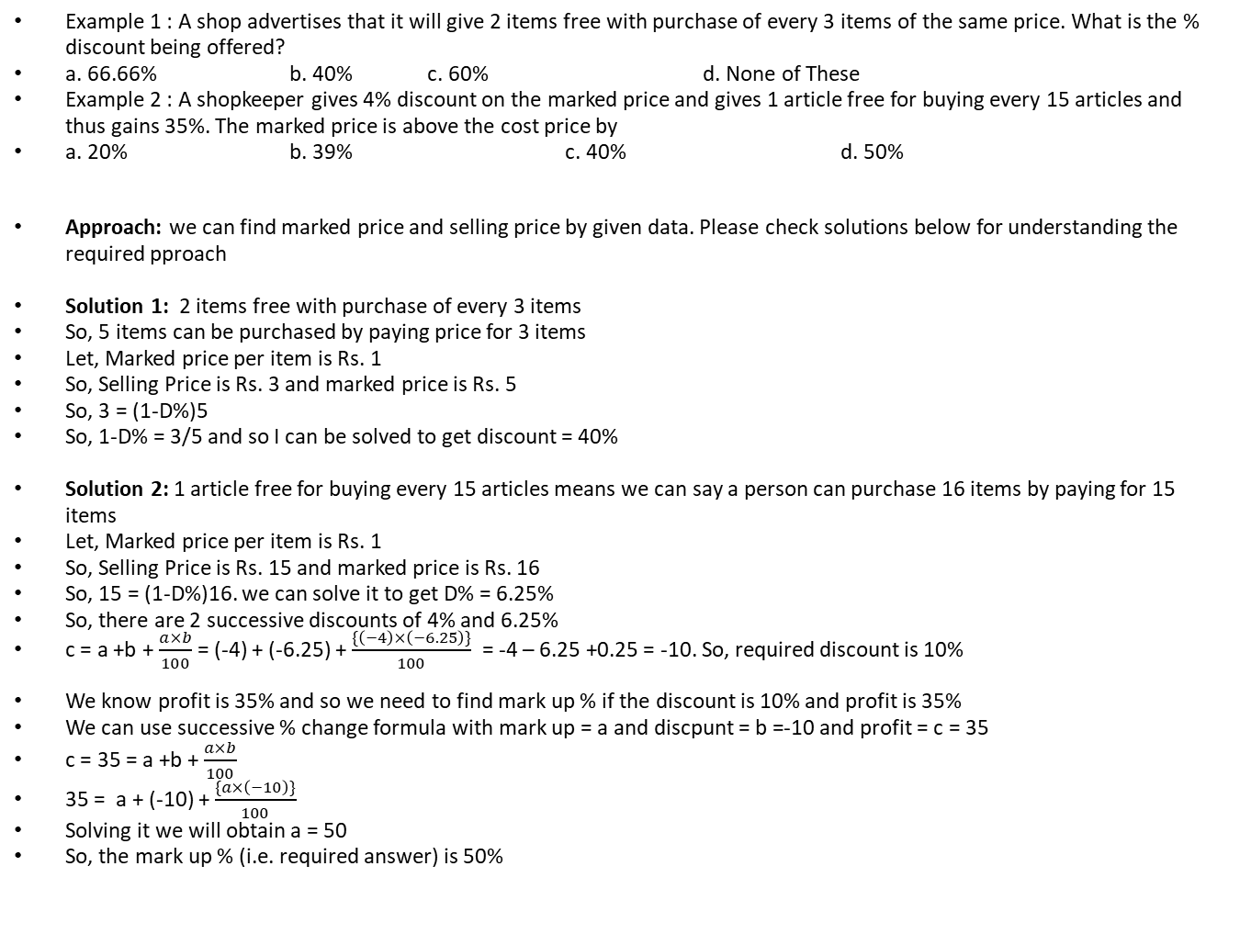
Free Items
Example 1 : A shop advertises that it will give 2 items free with purchase of every 3 items of the same price. What is the % discount being offered?
a. 66.66% b. 40% c. 60% d. None of These
Example 2 : A shopkeeper gives 4% discount on the marked price and gives 1 article free for buying every 15 articles and thus gains 35%. The marked price is above the cost price by
a. 20% b. 39% c. 40% d. 50%
Approach: we can find marked price and selling price by given data. Please check solutions below for understanding the required pproach
Solution 1: 2 items free with purchase of every 3 items
So, 5 items can be purchased by paying price for 3 items
Let, Marked price per item is Rs. 1
So, Selling Price is Rs. 3 and marked price is Rs. 5
So, 3 = (1-D%)5
So, 1-D% = 3/5 and so I can be solved to get discount = 40%
Solution 2: 1 article free for buying every 15 articles means we can say a person can purchase 16 items by paying for 15 items
Let, Marked price per item is Rs. 1
So, Selling Price is Rs. 15 and marked price is Rs. 16
So, 15 = (1-D%)16. we can solve it to get D% = 6.25%
So, there are 2 successive discounts of 4% and 6.25%
c = a +b + $\frac{a×b}{100}$ = (-4) + (-6.25) + $\frac{\{\left(−4\right)×\left(−6.25\right)\}}{100}$ = -4 – 6.25 +0.25 = -10. So, required discount is 10%
We know profit is 35% and so we need to find mark up % if the discount is 10% and profit is 35%
We can use successive % change formula with mark up = a and discpunt = b =-10 and profit = c = 35
c = 35 = a +b + $\frac{a×b}{100}$
35 = a + (-10) + $\frac{\{a×\left(−10\right)\}}{100}$
Solving it we will obtain a = 50
So, the mark up % (i.e. required answer) is 50%

Slide 18
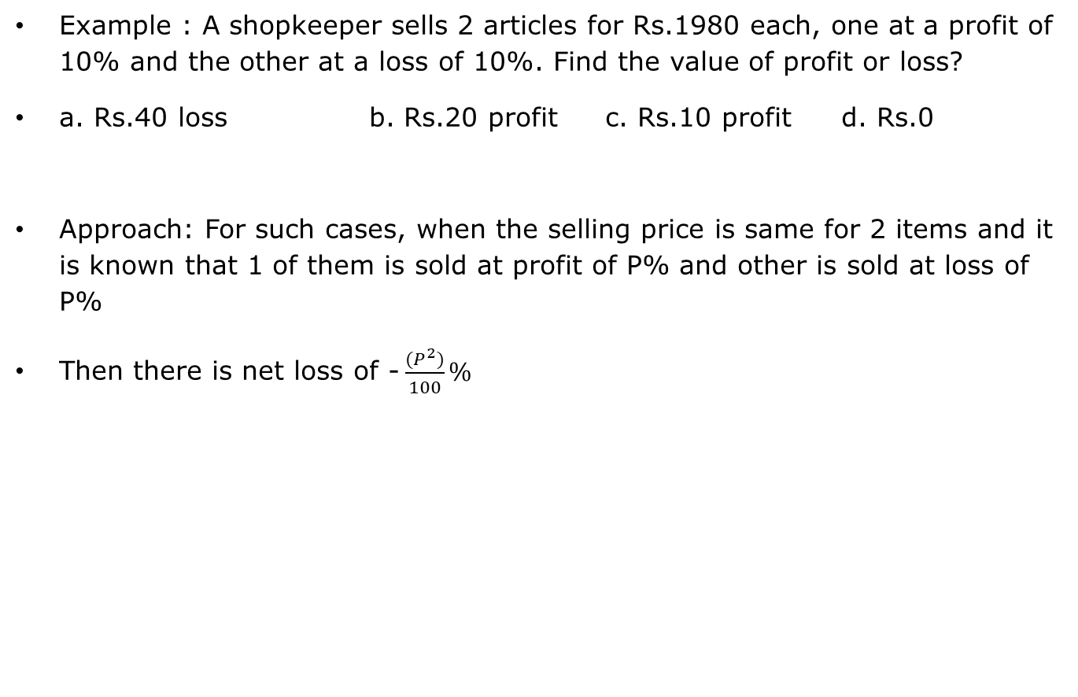
An important formula based problems
Example : A shopkeeper sells 2 articles for Rs.1980 each, one at a profit of 10% and the other at a loss of 10%. Find the value of profit or loss?
a. Rs.40 loss b. Rs.20 profit c. Rs.10 profit d. Rs.0
Approach: For such cases, when the selling price is same for 2 items and it is known that 1 of them is sold at profit of P% and other is sold at loss of P%
Then there is net loss of - $\frac{(P^{2})}{100}\%$

Slide 19
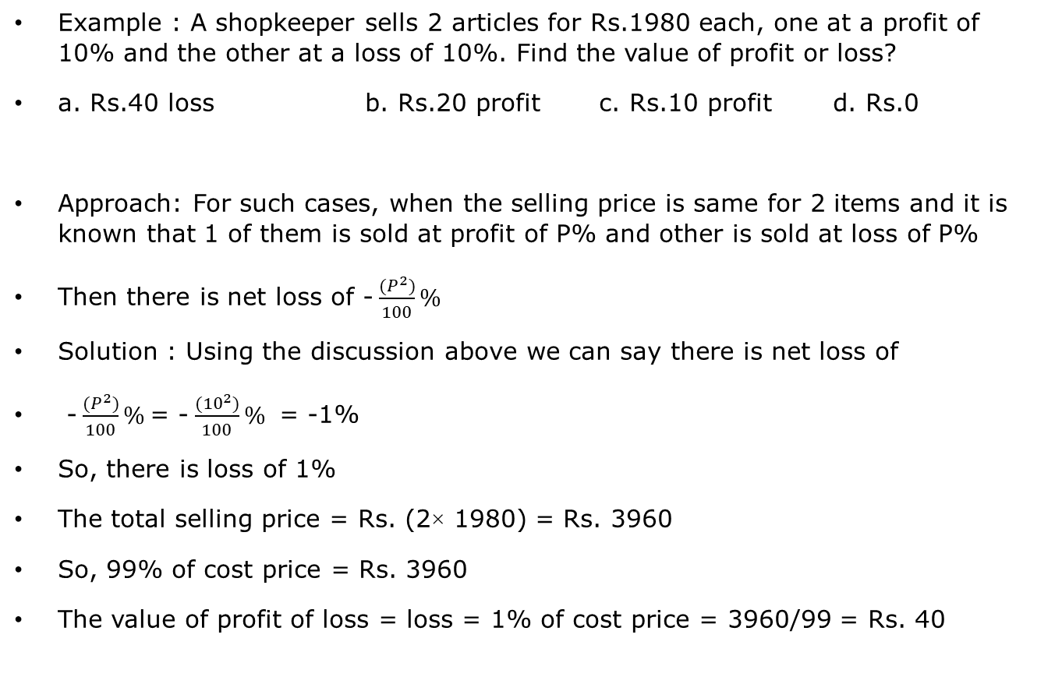
An important formula based problems
Example : A shopkeeper sells 2 articles for Rs.1980 each, one at a profit of 10% and the other at a loss of 10%. Find the value of profit or loss?
a. Rs.40 loss b. Rs.20 profit c. Rs.10 profit d. Rs.0
Approach: For such cases, when the selling price is same for 2 items and it is known that 1 of them is sold at profit of P% and other is sold at loss of P%
Then there is net loss of - $\frac{(P^{2})}{100}\%$
Solution : Using the discussion above we can say there is net loss of
- $\frac{(P^{2})}{100}\%$= - $\frac{({10}^{2})}{100}\%$ = -1%
So, there is loss of 1%
The total selling price = Rs. (2× 1980) = Rs. 3960
So, 99% of cost price = Rs. 3960
The value of profit of loss = loss = 1% of cost price = 3960/99 = Rs. 40

Slide 20
False weight
Simple way to solve these problems-
1. Let C.P. per gm or ml or cm = Rs. 1
2. Focus on what customer is paying for S.P.
3. Focus on what trader actually giving for C.P.
Compare S.P. and C.P.
As, S.P. = (1+P%) C.P.
(1-L%) C.P.

Slide 21
False weight
Q1 : A Milkman mixes 20 litres of water to 120 litres of Milk and sells it at cost price. Find the profit or loss %?
a. 14.28% profit b. 16.66% profit c. 20% profit d. 25% profit
Q2 : A dishonest trader uses 2 different weights of x and y gms to weigh an amount of 1000 gms in such a way that the percentage profit is 25%. If y is 50 grams more than x, find the value of x?
a. 425 gms b. 375 gms c. 800 gms d. 400 gms
Q3 : After adding 50 litres to a container having 250 litres of Milk, a milkman sells it to a customer at a mark-up of 25%. Find the overall percentage profit or loss?
a. 45% b. 40% c. 35% d. 50%
Q4 : A shopkeeper sells at Cost price and gains 16.66% by selling x gms instead of 1Kg. What is the value of x in grams?
800 b. 840 c. 857.10 d. 900
Q5 : A cloth merchant sells cloth at a Mark-up of 20%. Find the profit % in summer when the Meter scale expands by 10%?
7.5 % profit b. 8.09 % Profit c. No Profit, No loss d. Cannot be Determined
Q6 : The weighing balance of a Dealer shows 700 gms instead of 1 Kg. Find the profit or loss%?
30% loss b. 14.28% profit c. 42.84% loss d. None of These
Q7 : A Milkman mixes water to 125 litres of Milk to make it 130 litres and sells it at a Mark-up of 10%. Find the profit or loss %?
14 % profit b. 14.4 % profit c. 10 % profit d. 4 % loss
Q8 : A shopkeeper sells at 20% Mark-up and uses a weight of 800 gms instead of 1 kg. Find the profit or loss %?
45% b. 50% c. 40% d. 35%
Q9 : A Milkman sells Milk at 10% Mark-up and makes a profit of 21% by adding water. How much water must be added if the quantity of Milk is 125 litres?
25 litres b. 19 litres c. 15 litres d. 12.5 litres

